Slide 1

Basic Details of the Team and Problem Statement
Organization Name: AICTE, MIC-Student Innovation
PS Code: SM971
Problem Statement Title: To aid the problem of tracking humans quickly without risking more human lives in desperate times like disasters or terrorist attacks.
Team Name: EagleEye
Team Leader Name: Sushant Sharma
Institute Code (AISHE): C-28457
Institute Name: Dronacharya College of Engineering
Theme Name: Disaster Management

Slide 2
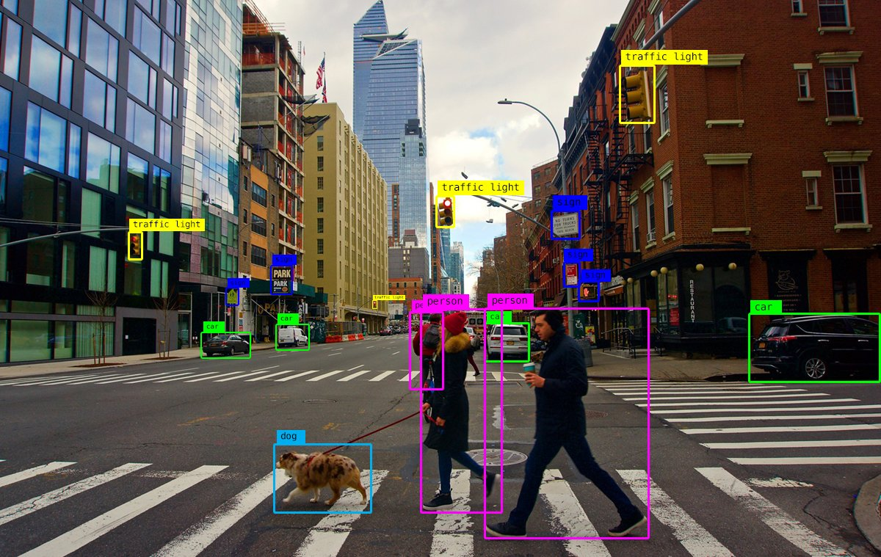
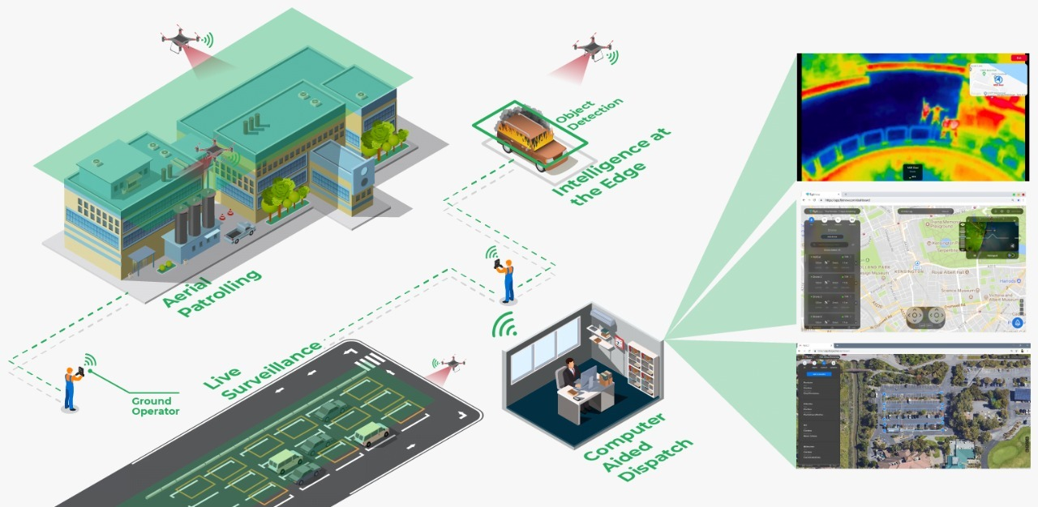




Idea/Approach Details
Describe your idea/Solution/Prototype here:
The concept of surveillance drones arises to aid the problem of tracking humans quickly without risking more human lives in desperate times like disasters or terrorist attacks.
The design consists of a Quad-Copter with a object detection camera and GPS to quickly track humans from distance on areas which are not quickly reachable from land and/or are not safe for a human to reach unknowingly.
The key element here is the detection of humans below rubbles in case of disaster and terrorists attacks.
Moving Object Detection is a technique used in Artificial Vision. It consists of processing the video so that any object moving within the field of view can be detected. This technique is used to recognize the movement of an object, vehicle, or person through a camera in an autonomous mode and displaying an alarm to the operator.
Storage Process
Describe your Technology stack here:

Slide 3
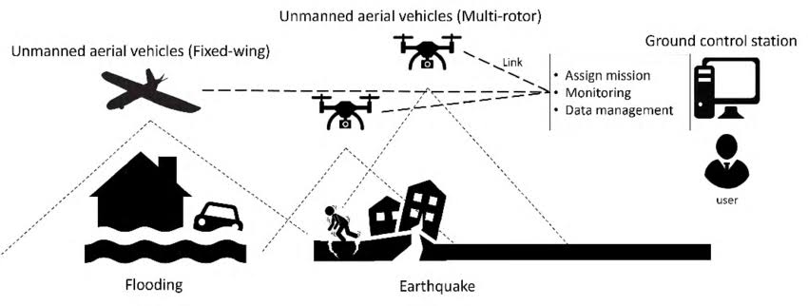
Idea/Approach Details
Describe your Use Cases here
Describe your Dependencies / Show stopper here
Upload a file
Search a file on the network
Access a file over IPFS
Register & authorize a new node
Drones, also called unmanned aerial vehicles (UAVs). Drones are operated through ground controlled computers and efficient navigation systems. Surveillance Drone refers to the act of keeping a visual track from the sky of an individual, objects, or a situation for the purpose of prevent any kind of threat.
GCS(Ground Control Station) software is typically run on a ground-based computer that is used for planning and flying a mission. It provides a map screen where the user can define waypoints for the flight, and see the progress of the mission.
Information is most important for taking decision. In the disaster/unpleasant condition the information is critical for taking decision.

Slide 4
Team Member Details
Team Leader Name: Sushant Sharma
Branch (Btech/Mtech/PhD etc): B. Tech. Stream (ECE, CSE etc): CSE Year (I,II,III,IV): III
Team Member 1 Name: Nikhil Tiwari
Branch (Btech/Mtech/PhD etc): B. Tech. Stream (ECE, CSE etc): CSE Year (I,II,III,IV): III
Team Member 2 Name: Yogesh Kumar
Branch (Btech/Mtech/PhD etc): B. Tech. Stream (ECE, CSE etc): CSE Year (I,II,III,IV): III
Team Member 3 Name: Anjali Kumari
Branch (Btech/Mtech/PhD etc): B. Tech. Stream (ECE, CSE etc): CSE Year (I,II,III,IV): III
Team Member 4 Name: Lakhan Singh
Branch (Btech/Mtech/PhD etc): B. Tech. Stream (ECE, CSE etc): CSE Year (I,II,III,IV): III
Team Member 5 Name: Anjali Pandey
Branch (Btech/Mtech/PhD etc): B. Tech. Stream (ECE, CSE etc): CSE Year (I,II,III,IV): III
Team Mentor 1 Name: Prof. Vimmi Malhotra
Category (Academic/Industry): Academic Expertise (AI/ML/etc): Information Security Domain Experience (in years): 8
Team Mentor 2 Name: Dr. Ashima Mehta
Category (Academic/Industry): Academic Expertise (AI/ML/ etc): Cloud Computing & security Domain Experience (in years): 8

